Slide 1
People are disturbed not by a thing, but by their perception of a thing
-Epictetus-
Notes:
From American Stress institute

Slide 2
Lets talk about Stress
Katie & Melissa York University Nursing students

Slide 3
What is stress?
Importance we attach to a thing
A physical pressure, pull or force
An experience of worry
An uncomfortable emotion
Physical experience
A mental evaluation of a situation
Anything that poses a challenge or a threat to our well-being
Physical, mental or emotional strain or tension
A condition or feeling experienced when a person perceives that demands exceeded the personal and social resources the individual is able to mobilize
Notes:
Stress is Something that effects everyone, but we are not always clear on what it is.
The truth is that there is no absolute definition for stress, it is subjective, and varies from person to person.
What is stress for you, may not be considered stressful to others.
These are common definitions of stress

Slide 4
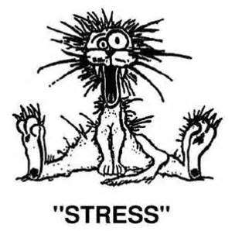
What is a Stressor?
An event or experience that causes a stress response
Notes:
What are some things that produce stress in you?
Major life events? (relationships, moving, divorced parents, death in the family)
Long term worries? (financial, school, illnesses)
Daily tasks (People, work, traffic, family)

Slide 5
Is it good or bad?
Good
Bad
Increased productivity
Passionate kiss
Winning a race
Great mark on a test
Acceptance into university
Winning money
Surgery
Break up
Loss of a job
Crashed your parents car
Punishment
Notes:
When you are affected by stress, is this a negative experience or a positive one.
How do we evaluate stress.
Good stress- something you are proud of, you are working hard to achieve something
Good stress is the feeling of excitement.
When we are talking about bad stress, this is the stress that invokes fear
What are some examples of good stress and bad stress
Is there ever a time when you hear of people seeking out good stress? These people are what we call adrenaline junkies.

Slide 6
How are you feeling?
Panic
Tension
Aches and pains
Chest pain
Anxiety
Jitteriness
Stomach tightness
Dry mouth
Increased heat rate
Notes:
Blow the whistle.. See how they react
Describe the physical feelings associated with acute stress.
Any feelings to add?

Slide 7
2 types of stress
Acute
Chronic
Short term
Fight or Flight
Survival instinct
Body is in defense mode
Stress we ignore
Builds up over time
Feeling of No way out
Longer than 6 months
Notes:
Acute stress can occur at any time
Chronic is when the stress is repeated. It is less manageable
Day after day…
Can anyone give an example of the difference between acute or chronic stress?
Maybe it’s a childhood stress.

Slide 8
Response to stress
1. Mobilizing energy
(ALARM)
Fight or Flight
2.Consuming energy
(RESISTANCE)
3.Draining energy supply (EXHAUSTION)
Notes:
Mobilize- you body releases adrenaline, your heart beats faster, you breathe more quickly
This happens when your body is threatened (we will touch more on this)
Consuming- you can’t get out of the stress, so your body releases more flue (sugars, fats) from its resources
your feeling driven, pressures, and tired, feeling anxiety, slight memory loss. Getting run down
You are adapting to the change
Draining Energy supply – You didn’t fix the problem, you are becoming chronically stressed..
you are feeling insomnia, thinking problems, personality changes, becoming sick

Slide 9
Good videos
http://www.youtube.com/watch?v=wyFPUvG-66E
http://www.youtube.com/watch?v=5J8kk0uWquc

Slide 10
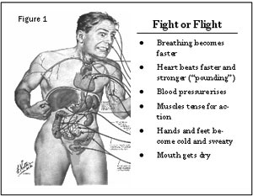
How does our body respond (Short term)
Notes:
Heat rate increases and blood pressure
Muscle contractions and tension
Body temp raises
Increase in epinephrine
You body is in immediate danger.. Its trying to save itself.
A survival mechanism programmed into your body… since cavemen

Slide 11
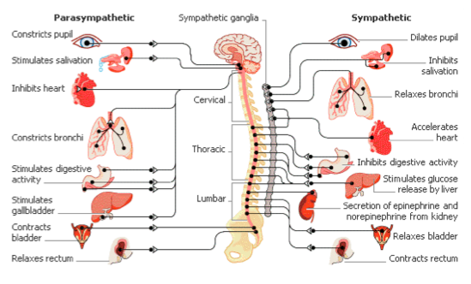

Slide 12
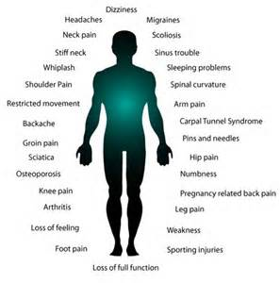
Long term
Notes:
If maintain this chronic state of stress… what else do you think can happen
If your stress persists and has no relief
Increased blood pressure
Closing throat
Change in sleep habits
Changes in skin… break outs
Change in weight
Sweating
Heartburn
Asthma
Dizziness
Pain
Backache
Sports injury
Run down

Slide 13
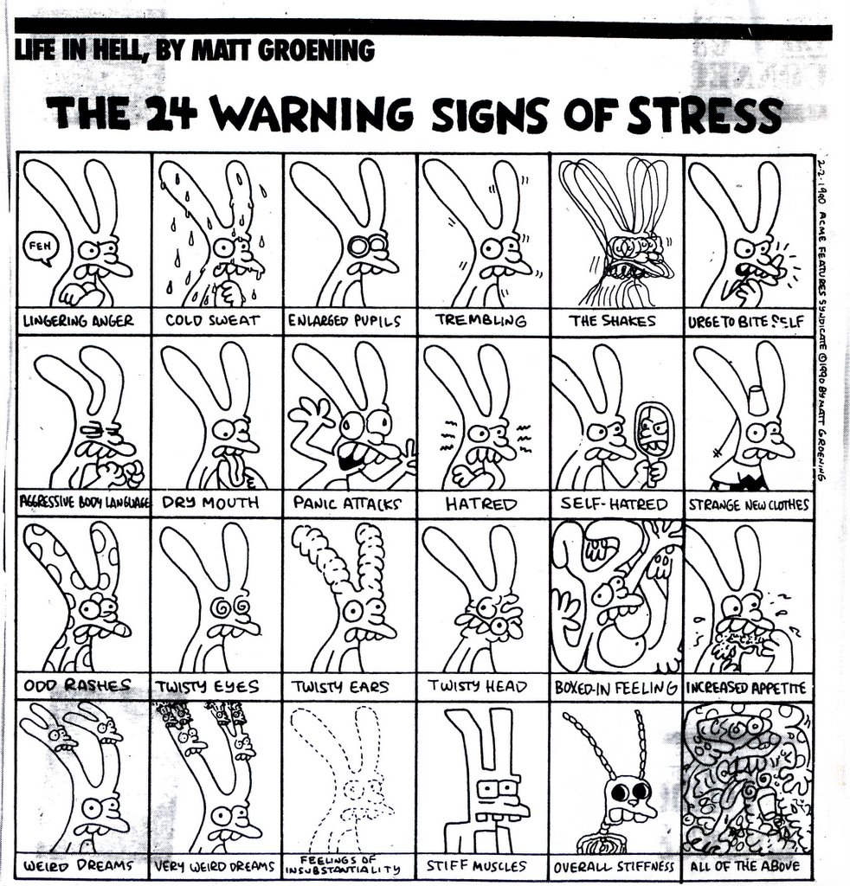

Slide 14
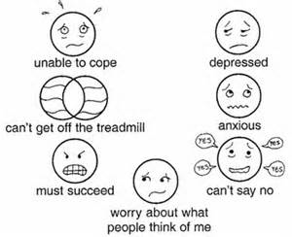
How does our mind respond?
Over thinking
Can’t focus/concentrate
Negative thoughts
Overwhelmed
Worried
Frustrated
Freaking out
Uncomfortable
Depressed
Notes:
How else does our mind react to stress?
Emotionally? And mentally?
What are some things that may be going through your mind?

Slide 15
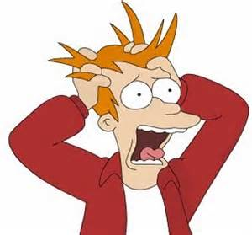
Is this a problem?
Insidious
Your body responds to stress the same way
Notes:
It sneaks up on you..
You don’t always see the signs or symptoms
And stems from a physiological foundation
It doesn’t matter what the stress is, it will invoke a stress response

Slide 16
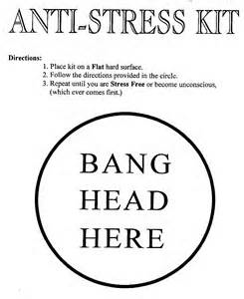
Common places where stress hides..
Home
School
Workplace
Relationships
Friends
Notes:
Can you add more areas to look out for,
Where stress can affect you and you may not be aware.

Slide 17
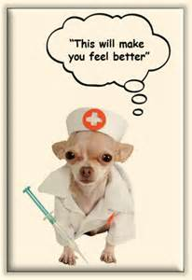
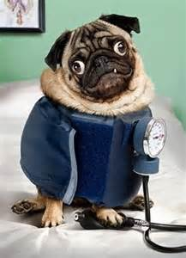
Questions?

